Slide 1

8th Grade Math: Pre-Algebra
Unit 8, Lesson 6 Solving Multi-Step Equations Volume 2, pg. 30

Slide 2


Benchmark
MA.8.AR.2.1
Solve multi-step linear equations in one variable, with rational number coefficients. Include equations with variables on both sides.
volume 2, pg. 30

Slide 3
Integrated Mathematical Thinking and Reasoning Standards
MA.K12.MTR.3.1 Complete tasks with mathematical fluency.
MA.K12.MTR.4.1 Engage in discussions that reflect on the mathematical thinking of self and others.
volume 2, pg. 30

Slide 4

Learning Target
I can solve multi-step linear equations with variables on both sides.
volume 2, pg. 30

Slide 5

Warm-Up
volume 2, pg. 31

Slide 6
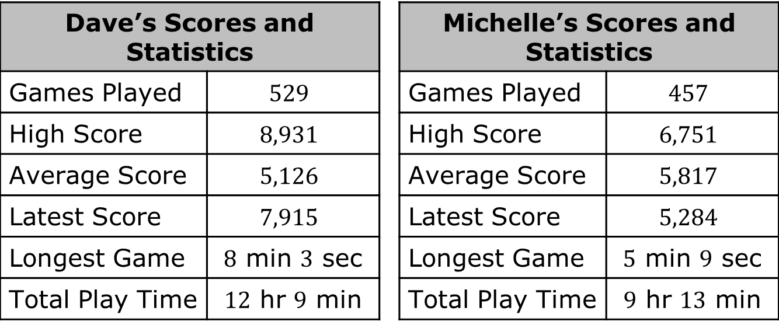
8.6.1 Warm-Up: Math Argument
Two friends, Dave and Michelle, play Candy Crave often. Their records are shown below.
Dave’s Scores and Statistics |  |  | Michelle’s Scores and Statistics
Games Played | $$529$$ |  | Games Played | $$457$$
High Score | $$8,931$$ |  | High Score | $$6,751$$
Average Score | $$5,126$$ |  | Average Score | $$5,817$$
Latest Score | $$7,915$$ |  | Latest Score | $$5,284$$
Longest Game | $8$ min $3$ sec |  | Longest Game | $5$ min $9$ sec
Total Play Time | $12$ hr $9$ min |  | Total Play Time | $9$ hr $13$ min
volume 2, pg. 31

Slide 7
Use information from the table to argue why Dave is the better player.
Use the same information to argue that Michelle is the better player instead.
volume 2, pg. 31

Slide 8

Collaboration
volume 2, pg. 31

Slide 9

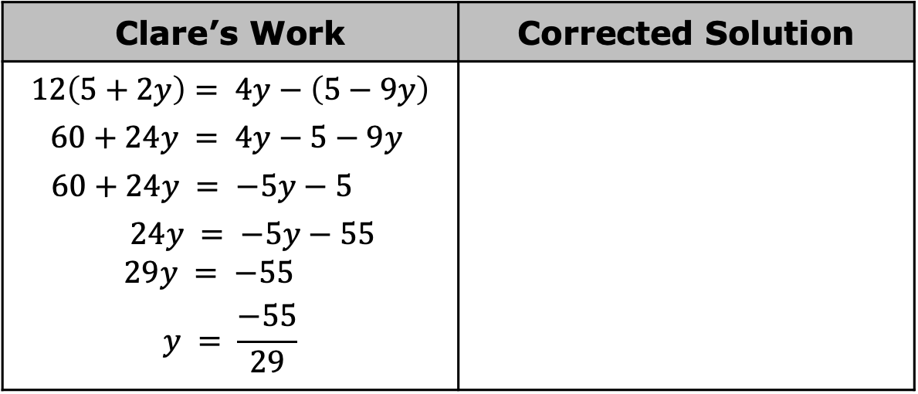
8.6.2 Collaboration: Finding the Error
Clare was solving an equation, but when she checked her solution, she noticed it was incorrect. She knows she made a mistake but cannot find it.
Clare’s work is shown.
Clare’s Work | Corrected Solution
$$12\left(5+2y\right)= 4y−\left(5−9y\right)$$ $$60+24y = 4y−5−9y$$ $$60+24y = −5y−5$$ $24y = −5y−55$ $29y = −55$ $$y = \frac{−55}{29}$$
volume 2, pg. 31

Slide 10
Discuss Clare’s work with your partner to find her mistake. Then, circle where she made the mistake.
Find the correct solution to the equation using the space provided above.
Verify your solution is correct using substitution.
volume 2, pg. 31

Slide 11

Activity
volume 2, pg. 32

Slide 12

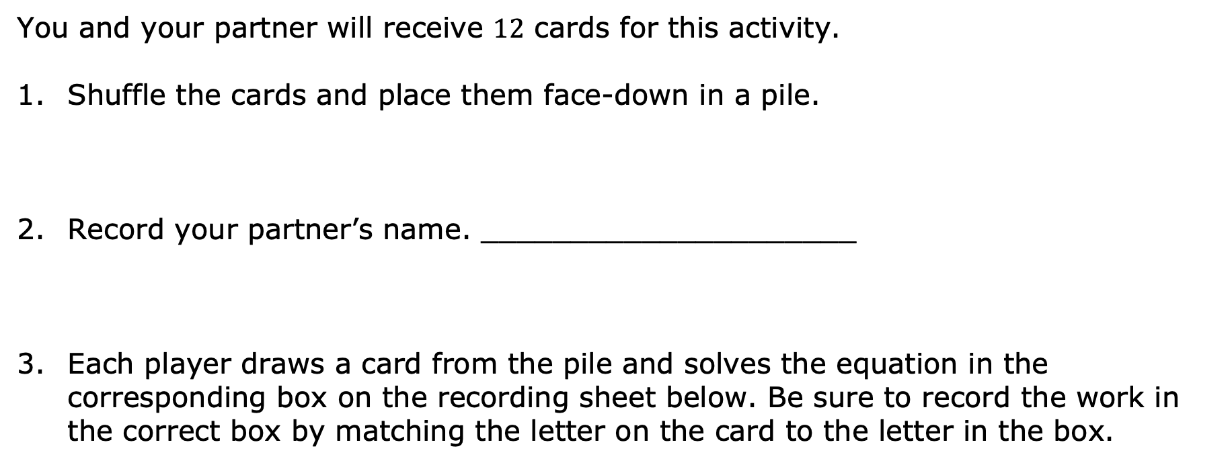
8.6.3 Activity: Solution Card Sort
You and your partner will receive $12$ cards for this activity.
Shuffle the cards and place them face-down in a pile.
Record your partner’s name. _____________________
Each player draws a card from the pile and solves the equation in the corresponding box on the recording sheet below. Be sure to record the work in the correct box by matching the letter on the card to the letter in the box.
volume 2, pg. 32

Slide 13
A | B
C | D
E | F
volume 2, pg. 32

Slide 14
G | H
I | J
K | L
volume 2, pg. 32

Slide 15
When all equations have been solved, sort the cards into groups based on their number of solutions. Write the letters that correspond to the cards in each group in the table below.
One Solution | No Solution | Infinitely Many Solutions
volume 2, pg. 32

Slide 16

Wrap-Up
volume 2, pg. 33

Slide 17



8.6.4 Wrap-Up: Reflection
Circle the icon that best describes your understanding of each concept.
I need help. | I got it. | I could help someone.
I can solve multi-step linear equations.
I can solve equations with variables on both sides.
I can relate solutions to equations to real-world contexts they model.
I can recognize equations with one, none, or infinitely many solutions.
volume 2, pg. 33

